Slide 1
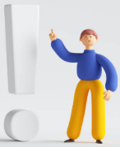
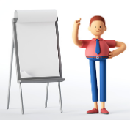
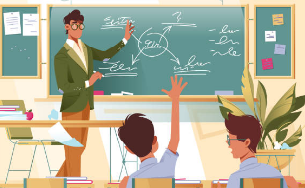
Kingdom Of Bahrain
Ministry Of Education
Al Monther Primary Boys school
Unit 5 : What’s the time?
To talk about daily routine.
Prepared by : Mr. Mahmoud
Principal Mr. Mohamed ELsamahegi
Senior Mr. Mohamed Fawzi

Slide 2
Objective-1
Watch the following video.
His daily routine.
What’s Mohamed talking about?
His family.

Slide 3
Watch the following video again.

Slide 4
Complete the following sentences
1- Mohamed gets up at ………….........in the morning.
5 O’clock
2- He goes to school at ………………..
7 O’clock
3- He goes to school by………..
bus
4- He has lunch at 2 O’clock in the………..
afternoon

