Slide 1
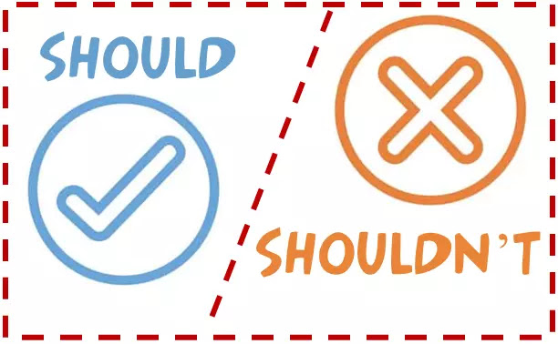
should/shouldn’t
Ahmed Mohamed Abdulla
6 / C

Slide 2
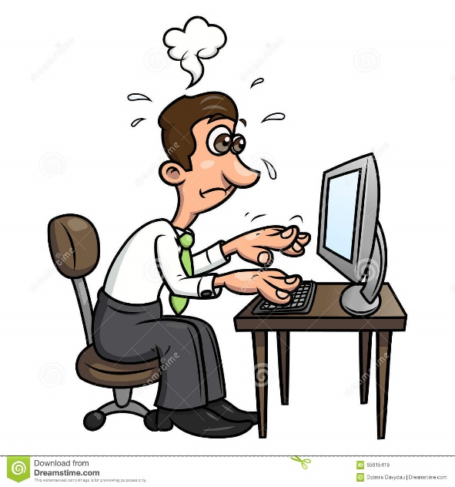
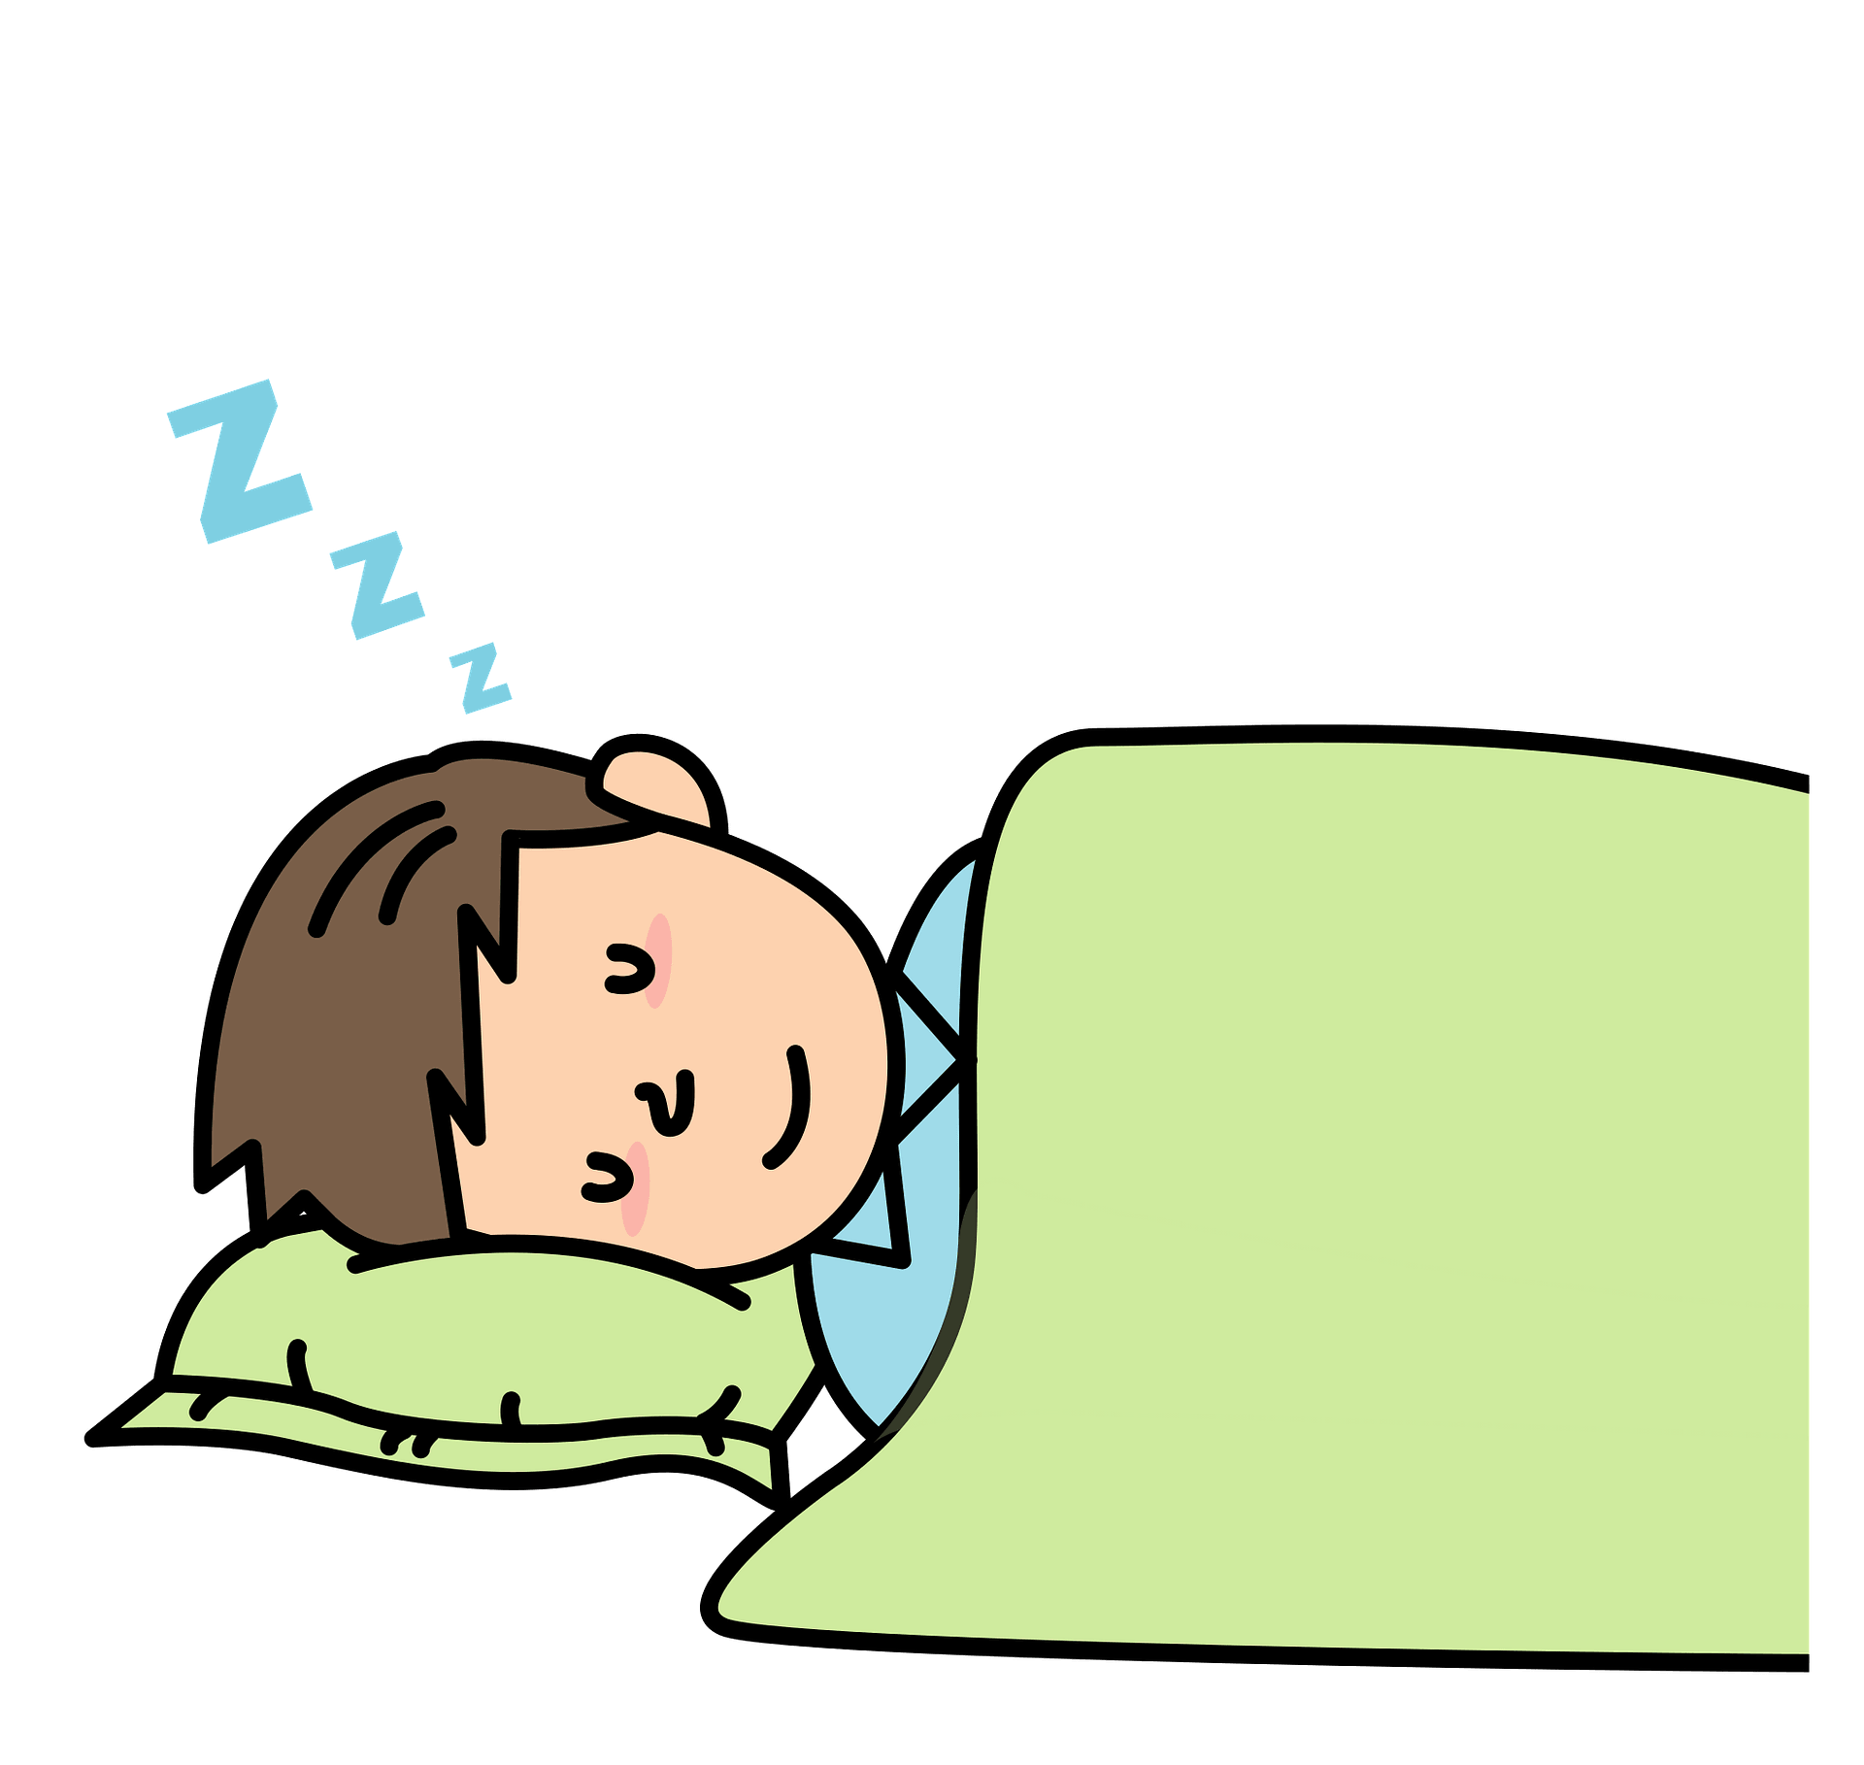
The Rule
We use should and shouldn’t to give advice or to talk about what we think is right or wrong
Example
You look tired
You should go to bed

Slide 3
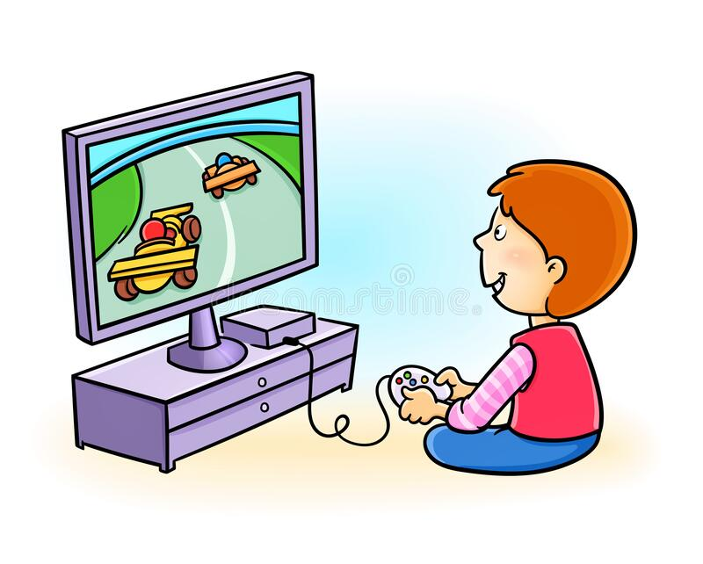
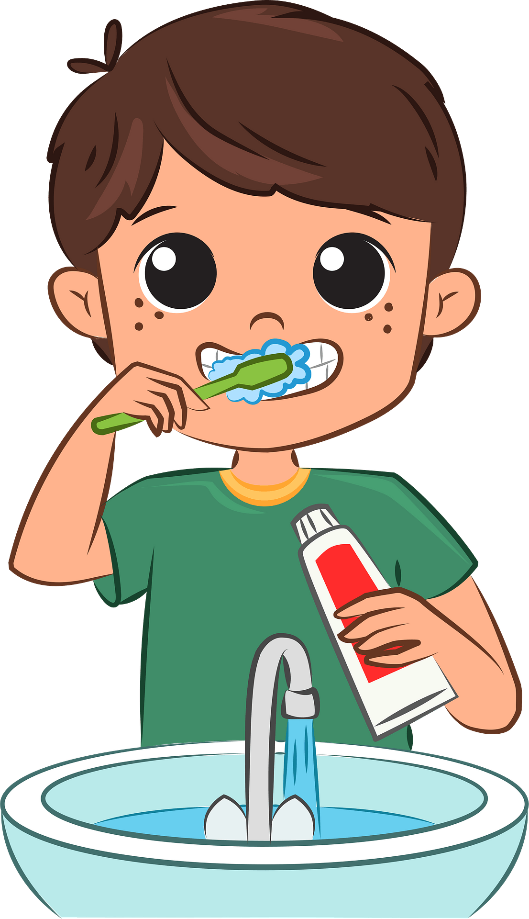
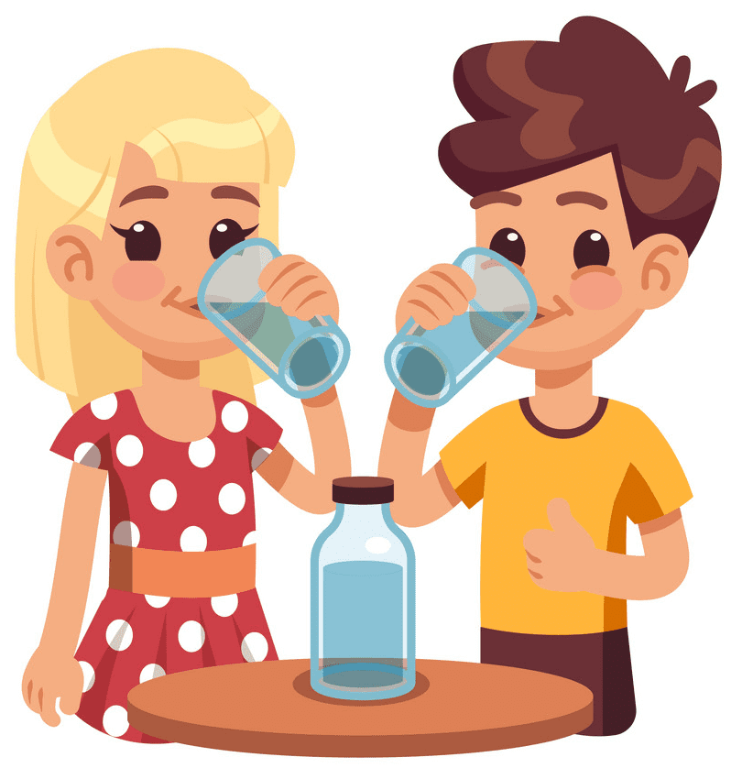
He shouldn’t play a lot of video games
You should brush your teeth
We Should drink a lot of water

Slide 4
Circle the correct option
You should / shouldn’t brush your teeth twice a day to have a bright smile
People should / shouldn’t hurt the animals because they are our friends
It is going to rain . You should / shouldn't take an umbrella
We should / shouldn't sleep at night to be fresh
We should / shouldn't help old people

Slide 5
Circle the correct option
You should / shouldn’t brush your teeth twice a day to have a bright smile
People should / shouldn’t hurt the animals because they are our friends
It is going to rain . You should / shouldn't take an umbrella
We should / shouldn't sleep at night to be fresh
We should / shouldn't help old people

