Slide 1
Grade 5
Unit 6
How much time have we got?
Lesson 2
Prepared by : Mohammed Erakat
Teacher of English Language
The Primary Religious Institute

Slide 2
Lesson Objectives
1-To identify countable and uncountable nouns.

Slide 3
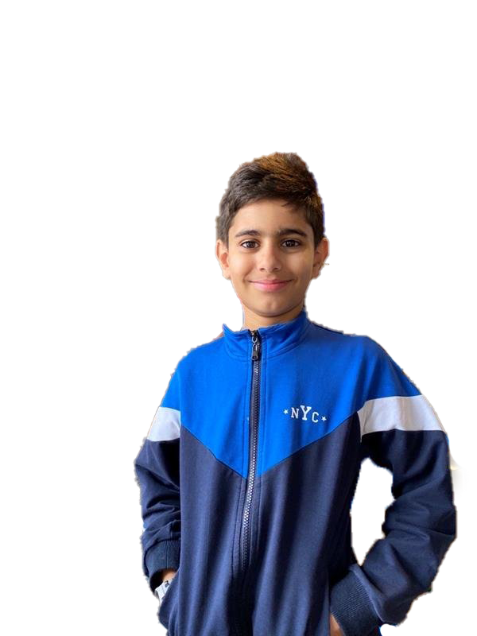
Presentation
Our Little Teacher
COUNTABLE / UNCOUNTABLE NOUS
What are Countable Nouns ?
Countable nouns are nouns that you can count
you can use (a / an) in front of countable nouns.
For example:
a cat cats / an apple apples
Nouns that have a plural form.
We use
How many + countable noun
Ex. How many suitcases/cons have you got?

Slide 4
Presentation
Our Little Teacher
COUNTABLE / UNCOUNTABLE NOUS
What are uncountable nouns ?
Uncountable nouns are nouns that you can´t count
Normally, you can´t use (a / an) in front of them Some examples of uncountable nouns (water / tea /money/ luggage…….etc.)
Uncountable nouns are nouns that normally don´t have a plural form
moneys x
How much + uncountable noun
Ex. : How much luggage/money have you got?

Slide 5
Assessment (1)
Put the words in the right place:
money
suitcases
luggage
apples
water
coins
milk
passengers
Countable Nouns
_______________________________________________________________________________________________________________
Uncountable Nouns
________________________________________________________________________________________________________________

Slide 6
Assessment (1) Model Answer
Put the words in the right place:
Countable Nouns
_______________________________________________________________________________________________________________
Uncountable Nouns
________________________________________________________________________________________________________________
suitcases
money
apples
luggage
coins
water
passengers
milk

