Slide 1
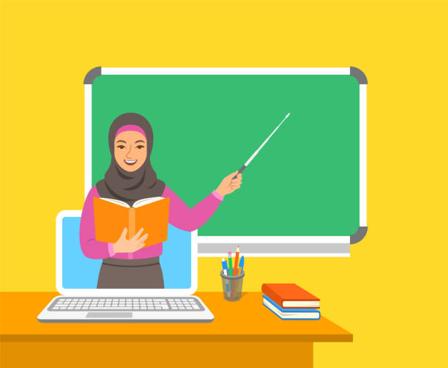
Family and Friends 5
Grade 5
Unit 8 lesson 8
Go back to the roundabout!
Headmaster: T.Khulood Ebrahim Alsadoon Senior Teacher: T. Amal Mohammed Al-Muradi
Assistant Headmaster: T. Nasra Saif Done By: T. Noura Soliman Mohamed

Slide 2
